Slide 1
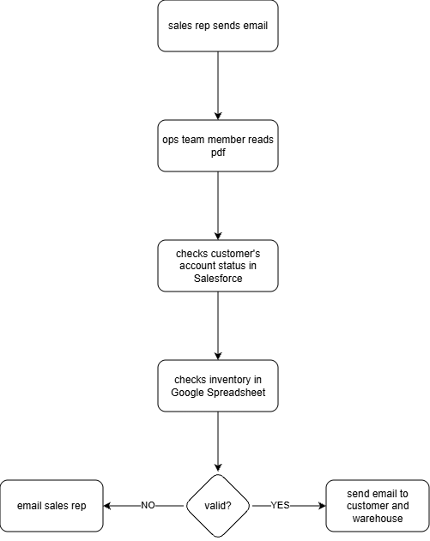
The Problem:
Our Current Order Process Is a Bottleneck.

Slide 2
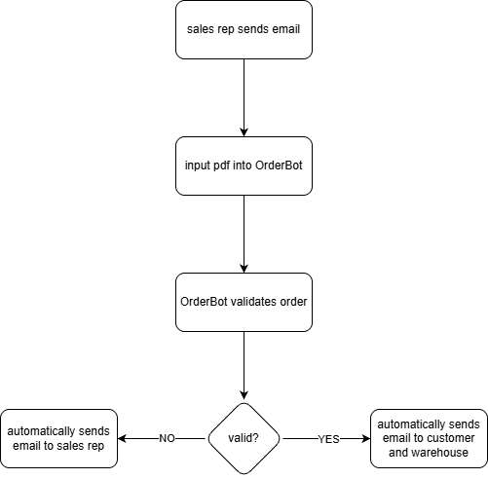
The Solution: Introducing 'OrderBot,' Our Autonomous AI Agent.
Can make this process manual if it is too difficult for OrderBot to read the pdf
Checks Salesforce and the Google Spreadsheet by itself

Slide 3
The Business Impact & Recommended Next Steps.
Most of the process would be automatic
24/7 availability for the automatic processes
Human error when validating order is completely eliminated
Reduce processing time from hours to minutes
Improve customer satisfaction

